Slide 1


UNIVERSITY INSTITUTE OF ENGINEERING
COMPUTER SCIENCE & ENGINEERING
Introduction to Information Security
(Subject Code: 20CST-354/ITT-354)
Prepared By : Er. Puneet kaur (E6913)
INTRODUCTION
DISCOVER . LEARN . EMPOWER

Slide 2

Lecture – 3
Substitution Techniques
www. cuchd.in Campus : Gharaun, Mohali

Slide 3
Substitution Techniques
Caeser Cipher
Monoalphabetic Ciphers
Playfair Cipher
Polyalphabetic Ciphers
One-Time PAD

Slide 4
Caesar Cipher
Earliest known substitution cipher
Invented by Julius Caesar
Each letter is replaced by the letter three positions further down the alphabet.
Plain: a b c d e f g h i j k l m n o p q r s t u v w x y z Cipher: D E F G H I J K L M N O P Q R S T U V W X Y Z A B C
Example: ohio state → RKLR VWDWH

Slide 5
Caesar Cipher
Mathematically, map letters to numbers:
a, | b, | c, | ..., | x, | y, | z
0, | 1, | 2, | ..., | 23, | 24, | 25
Then the general Caesar cipher is:
c = E_{K}(p) = (p + k) mod 26
p = D_{K}(c) = (c – k) mod 26
Can be generalized with any alphabet.

Slide 6
Cryptanalysis of Caesar Cipher
Key space: {0, 1, ..., 25}
Vulnerable to brute-force attacks.
E.g., break ciphertext "UNOU YZGZK“
Need to recognize it when have the plaintext

Slide 7
Monoalphabetic Substitution Cipher
Shuffle the letters and map each plaintext letter to a different random ciphertext letter:
Plain letters:
abcdefghijklmnopqrstuvwxyz
Cipher letters: DKVQFIBJWPESCXHTMYAUOLRGZN Plaintext: ifwewishtoreplaceletters
Ciphertext: WIRFRWAJUHYFTSDVFSFUUFYA
What does a key look like?

Slide 8
Monoalphabetic Cipher Security
Now we have a total of 26! keys.
With so many keys, it is secure against brute-force attacks.
But not secure against some cryptanalytic attacks.
Problem is language characteristics.

Slide 9
Language Statistics and Cryptanalysis
Human languages are not random.
Letters are not equally frequently used.
In English, E is by far the most common letter, followed by T, R, N, I, O, A, S.
Other letters like Z, J, K, Q, X are fairly rare.
There are tables of single, double & triple letter frequencies for various languages

Slide 10
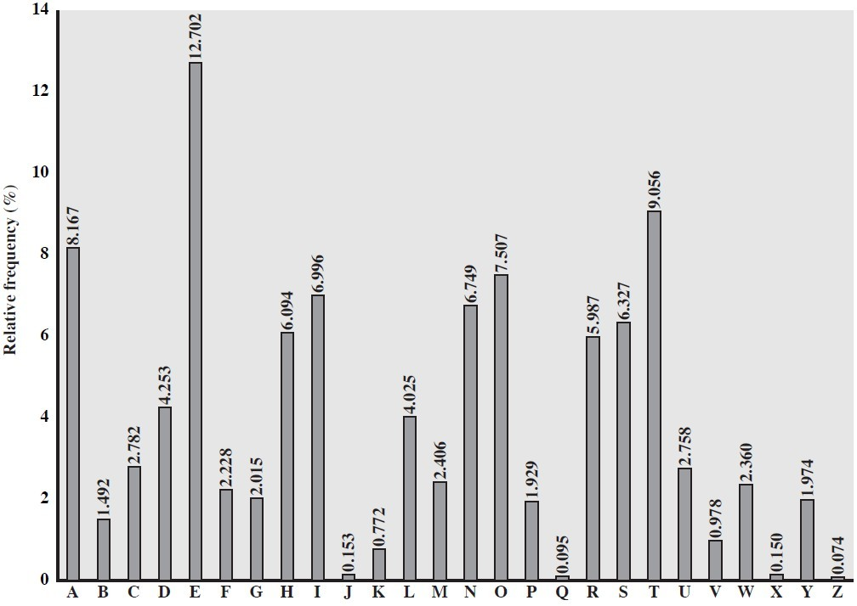
English Letter Frequencies

Slide 11
Statistics for double & triple letters
Double letters:
th he an
Triple letters:
in er re es on, …
the and ent ion tio for nde, …

Slide 12
Use in Cryptanalysis
Key concept: monoalphabetic substitution does not change relative letter frequencies
To attack, we
calculate letter frequencies for ciphertext
compare this distribution against the known one

Slide 13
Example Cryptanalysis
Given ciphertext:
UZQSOVUOHXMOPVGPOZPEVSGZWSZOPFPESXUDBMETSXAIZ VUEPHZHMDZSHZOWSFPAPPDTSVPQUZWYMXUZUHSX EPYEPOPDZSZUFPOMBZWPFUPZHMDJUDTMOHMQ
Count relative letter frequencies (see next page)
Guess {P, Z} = {e, t}
Of double letters, ZW has highest frequency, so guess ZW = th and hence ZWP = the
Proceeding with trial and error finally get:
it was disclosed yesterday that several informal but direct contacts have been made with political representatives of the viet cong in moscow

Slide 14
Letter frequencies in ciphertext
P | 13.33 | H | 5.83 | F | 3.33 | B | 1.67 | C | 0.00
Z | 11.67 | D | 5.00 | W | 3.33 | G | 1.67 | K | 0.00
S | 8.33 | E | 5.00 | Q | 2.50 | Y | 1.67 | L | 0.00
U | 8.33 | V | 4.17 | T | 2.50 | I | 0.83 | N | 0.00
O | 7.50 | X | 4.17 | A | 1.67 | J | 0.83 | R | 0.00
M | 6.67

Slide 15
Playfair Key Matrix
Use a 5 x 5 matrix.
Fill in letters of the key (w/o duplicates).
Fill the rest of matrix with other letters.
E.g., key = MONARCHY.
M | O | N | A | R
C | H | Y | B | D
E | F | G | I/J | K
L | P | Q | S | T
U | V | W | X | Z

Slide 16
Encrypting and Decrypting
Plaintext is encrypted two letters at a time.
If a pair is a repeated letter, insert filler like 'X’.
If both letters fall in the same row, replace each with the letter to its right (circularly).
If both letters fall in the same column, replace each with the the letter below it (circularly).
Otherwise, each letter is replaced by the letter in the same row but in the column of the other letter of the pair.

Slide 17
Security of Playfair Cipher
Equivalent to a monoalphabetic cipher with an alphabet of 26 x 26 = 676 characters.
Security is much improved over the simple monoalphabetic cipher.
Was widely used for many decades
– eg. by US & British military in WW1 and early WW2
Once thought to be unbreakable.
Actually, it can be broken, because it still leaves some structure of plaintext intact.

Slide 18
Polyalphabetic Substitution Ciphers
A sequence of monoalphabetic ciphers (M₁, M₂, M₃, ..., M_{k}) is used in turn to encrypt letters.
A key determines which sequence of ciphers to use.
Each plaintext letter has multiple corresponding ciphertext letters.
This makes cryptanalysis harder since the letter frequency distribution will be flatter.

Slide 19
Vigenère Cipher
Simplest polyalphabetic substitution cipher
Consider the set of all Caesar ciphers:
{ C_{a}, C_{b}, C_{c}, ..., C_{z} }
Key: e.g. security
Encrypt each letter using C_{s}, C_{e}, C_{c}, C_{u}, C_{r}, C_{i}, C_{t}, C_{y} in turn.
Repeat from start after C_{y}.
Decryption simply works in reverse.

Slide 20
Example of Vigenère Cipher
Keyword: deceptive
key: deceptivedeceptivedeceptive plaintext: wearediscoveredsaveyourself ciphertext: ZICVTWQNGRZGVTWAVZHCQYGLMGJ

Slide 21
Security of Vigenère Ciphers
There are multiple (how many?) ciphertext letters corresponding to each plaintext letter.
So, letter frequencies are obscured but not totally lost.
To break Vigenere cipher:
Try to guess the key length. How?
If key length is N, the cipher consists of N Caesar ciphers. Plaintext letters at positions k, N+k, 2N+k, 3N+k, etc., are encoded by the same cipher.
Attack each individual cipher as before.

Slide 22
Guessing the Key Length
Main idea: Plaintext words separated by multiples of the key length are encoded in the same way.
In our example, if plaintext = “…thexxxxxxthe…” then “the” will be encrypted to the same ciphertext words.
So look at the ciphertext for repeated patterns.
E.g. repeated “VTW” in the previous example suggests a key length of 3 or 9:
ciphertext:
ZICVTWQNGRZGVTWAVZHCQYGLMGJ
Of course, the repetition could be a random fluke.

Slide 23
References
http://www.brainkart.com/article/Classical-Encryption-Techniques_8339/
https://www.tutorialspoint.com/cryptography/index.htm
https://www.geeksforgeeks.org/cryptography-introduction/
https://www.techopedia.com/definition/1770/cryptography#:~:text=Cryptography%20involves%20creating%20written%20or,information%20to%20be%20kept%20secret.&text=Information%20security%20uses%20cryptography%20on,transit%20and%20while%20being%20stored.
https://www2.slideshare.net/lineking/classical-encryption-techniques-in-network-security?qid=e388c29f-793d-4f2b-bcaf-9d22e9ca07b5&v=&b=&from_search=1

